Slide 1
SW Test Demo
RiskPoint Group DK

Slide 2
Test Environment Setup
Planning
Execution
Results
Requirements Gathering
Define Scenarios
Bug Reporting
Test Plan
Test Scripting
Test Report
Test Strategy
Notes:
Steps considered to define th scenarios
Understand the purpose
Gather Requirements and Information
Define the Actors
Create the scenario outline
Consider variations and Edge cases
Document the scenario
Review and Validate
Implement and Test

Slide 3
Requirements
Functional Requirements:
Navigation: Ensure that all menu items, links, and buttons are functioning correctly (www.rpgroup.com)
Forms: Test all forms on the site (e.g., Report a claim) for correct data submission, validation, and error handling.
Content Management: Verify that the content on the website (text, images, videos) is displayed correctly and can be updated as needed (Accident & Health on report a Claim page).
Non-Functional Requirements:
Performance:
Load Time: Verify that each page on the website loads within an acceptable timeframe (e.g., under 3 seconds).
Usability:
Responsiveness: Test the website with different screen sizes to ensure it is responsive and user friendly.
Accessibility: Ensure the website is accessible to all types of users.
Content Requirements:
Accuracy: Check that all content is accurate, up-to-date, and free from spelling or grammatical errors.

Slide 4
Test Plan
Purpose: The purpose of this test plan is to outline the testing strategy for the RiskPoint Group website. The goal is to ensure that the website meets all specified functional & non-functional requirements, providing a seamless experience to the users.
Scope: This test plan covers the testing of all features and functionalities of the RiskPoint Group website, including the user interface, navigation, content management, and backend integration.
Objectives:
Validate that the website meets all functional requirements as specified in the Business Requirements Document (BRD).
Ensure the website is user-friendly, responsive, and accessible across different devices and browsers.
Verify the accuracy of content, including text, images, links, and downloadable resources.
Assess the website's performance under various load conditions.
Ensure security compliance and data protection standards.
Features tested:
Homepage: Validate content, layout, and navigation.
Claims Tab: Test content accuracy.
Report a Claim Page: Verify selection of Claim Type, selection of Language, navigating to the details page to fill the form in respective language and downloadable resources.
Claims Details page: Filling up the details in the respective language, validate the fields, ensure that the details are submitted successfully.

Slide 5
Test Strategy
The Test Strategy aims to define the approach and guidelines for testing the RiskPoint Group website. It ensures that all testing activities align with the project’s objectives, deliverables, and quality standards.
Testing Types:
Functional Testing: Validate that the website works as expected according to the requirements.
UI/UX Testing: Ensure the user interface is intuitive and provides a positive user experience.
Regression Testing: Ensure that changes and updates do not affect existing functionality.
Testing Levels:
Integration Testing: Test the interaction between different modules or components.
System Testing: Validate the complete functionality of the website as a whole.
Test Approaches:
Manual Testing: Used for UI/UX, content verification, and exploratory testing.
Automated Testing: Implemented for regression testing
Test Environment: The test environment will closely resemble the production environment.

Slide 6
Test Environment
Software:
Operating Systems: Windows, Mac
Browser: Chrome
Testing Tools:
Python
Selenium web driver
Cucumber framework
Github
Network:
Internet connection with standard security protocols.

Slide 7
Define Scenarios
Scenarios for the “RiskPoint Group” website are identified based on the understanding of the end user.
These scenarios for the website has been authored using BDD framework Cucumber and Gherkin script, for the easy understanding of test being done on the website (audience such as end-user, testers or stakeholders).
Below is a sample of the scenario in BDD framework for one of the test script.
Feature: Claims
Scenario: Verify the Home Page of RiskPoint Group
Given I am on the home page of 'rpgroup.com'
When On the home page User hovers on Claims tab
Then Emergency Contacts section should be displayed
And Report a Claim section should be displayed

Slide 8
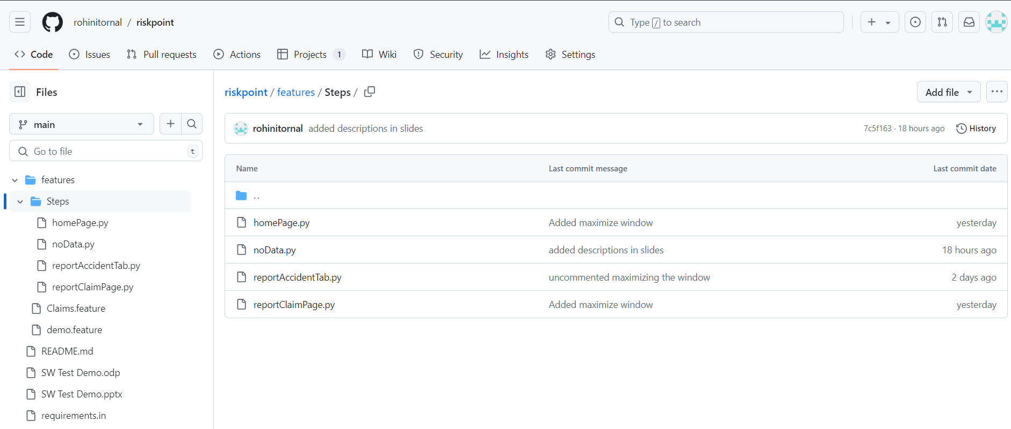
GitHub Repository
https://github.com/rohinitornal/riskpoint

Slide 9
Test script
Virtual environment
Install libraries - selenium, behave
Create Feature file using Gherkin script
Create Step file using python script
Run using behave

Slide 10
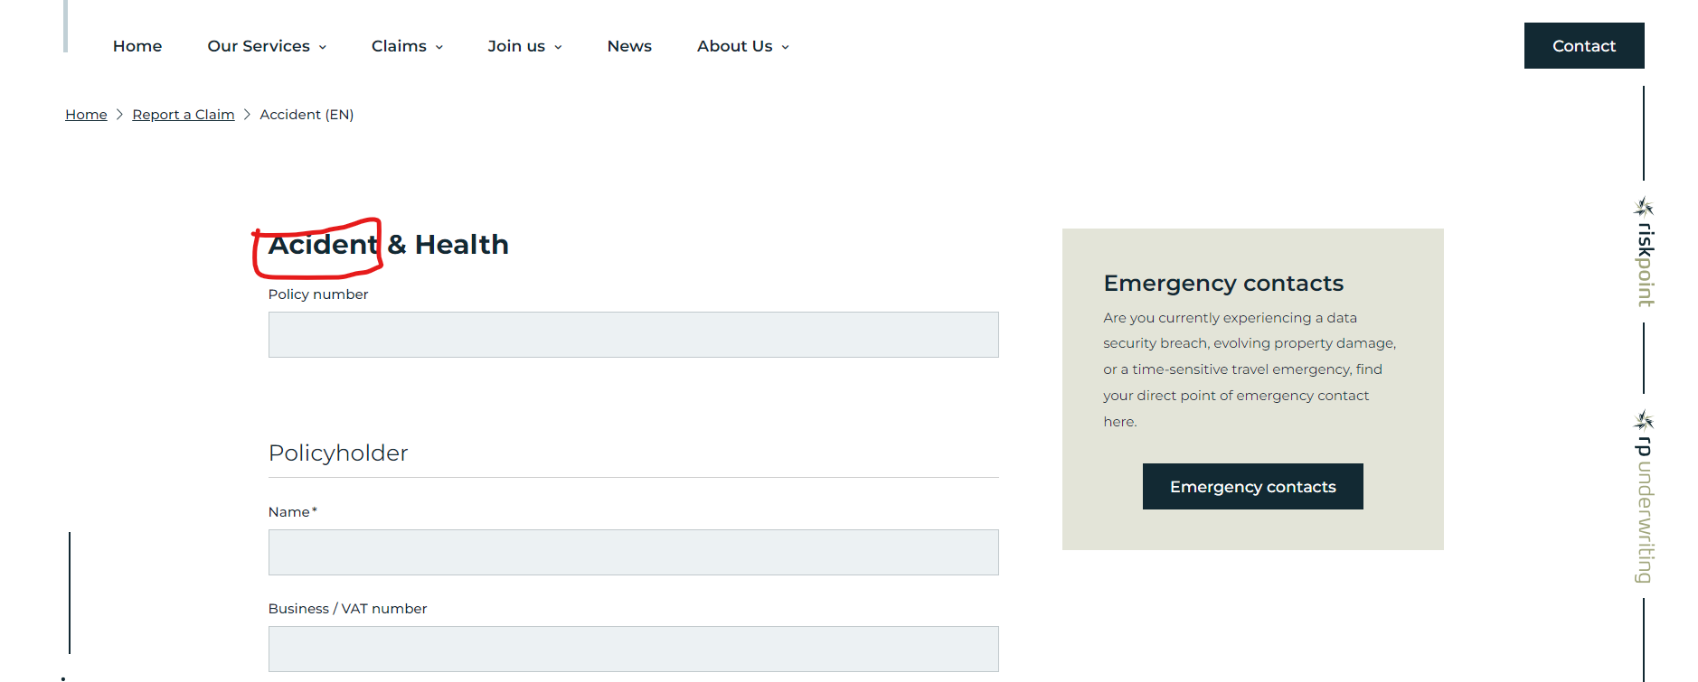
Bug Report

Slide 11
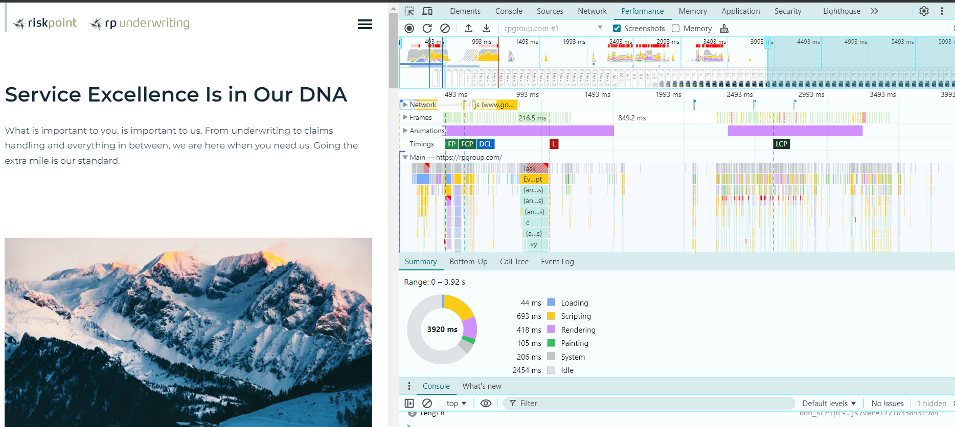
Performance Test

Slide 12
Final Test Report

